Slide 1
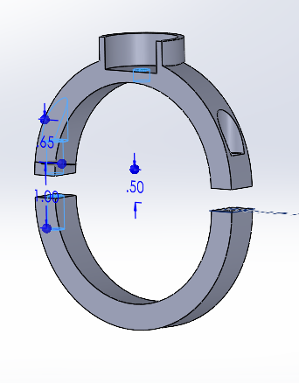
Progress
Future Steps
Problems
Basic outline of Camera mount on UR
Completed Training
Learn basic commands on UR robot
Download visual Studio
Set up GitHub
Print 3D model on Envy
Look at printer
Test and modify model
Start coding on robot
Sloth 3D Printer is jammed

